Slide 1

8th Grade Math: Pre-Algebra
Unit 4, Lesson 9 Algebraic Expressions with Negative Exponents Volume 1, pg. 161

Slide 2


Benchmark
MA.8.AR.1.1
Apply the Laws of Exponents to generate equivalent algebraic expressions, limited to integer exponents and monomial bases.
volume 1, pg. 161

Slide 3
Integrated Mathematical Thinking and Reasoning Standards
MA.K12.MTR.1.1 Actively participate in effortful learning both individually and collectively.
MA.K12.MTR.2.1 Demonstrate understanding by representing problems in multiple ways.
MA.K12.MTR.3.1 Complete tasks with mathematical fluency.
MA.K12.MTR.5.1 Use patterns and structure to help understand and connect mathematical concepts.
volume 1, pg. 161

Slide 4

Learning Target
I can write an equivalent algebraic expression by applying the laws of exponents.
volume 1, pg. 161

Slide 5

Warm-Up
volume 1, pg. 162

Slide 6
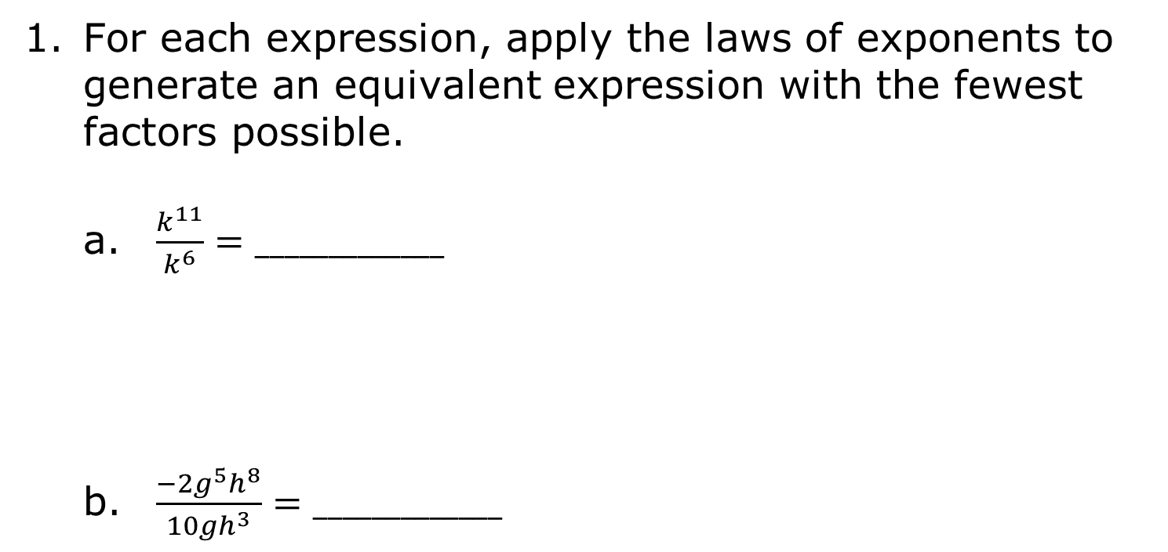
4.9.1 Warm-Up: Bell Work
For each expression, apply the laws of exponents to generate an equivalent expression with the fewest factors possible.
$\frac{k^{11}}{k^{6}}=_____________$
$\frac{{−2g}^{5}h^{8}}{{10gh}^{3}}=_____________$
volume 1, pg. 162
Notes:
Video Link: https://algebranation.wistia.com/medias/fi4fidi5y8

Slide 7

$z^{3}∙z^{8}$ $= _____________$
${\left(\frac{1}{3}x^{2}∙y\right)}^{4}= _____________$
volume 1, pg. 162
Notes:
Video Link: https://algebranation.wistia.com/medias/fi4fidi5y8

Slide 8

Collaboration
volume 1, pg. 162

Slide 9

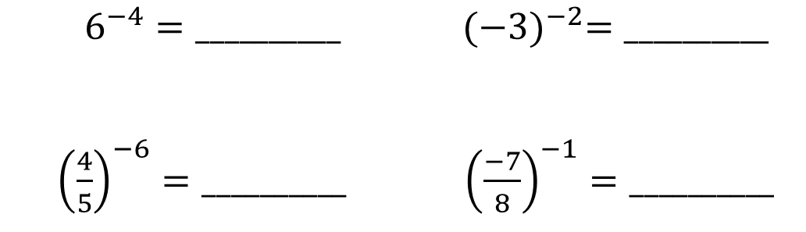

4.9.2 Collaboration: Negative Exponents in Algebraic Expressions
Rewrite each expression using positive exponents.
Make a conjecture on how to rewrite an algebraic expression with a negative exponent.
$$x^{−3}= _____$$
$$6^{−4}=__________$$ | $${(−3)}^{−2}=__________$$
${\left(\frac{4}{5}\right)}^{−6}=__________$ | ${\left(\frac{−7}{8}\right)}^{−1}=__________$
volume 1, pg. 162

Slide 10
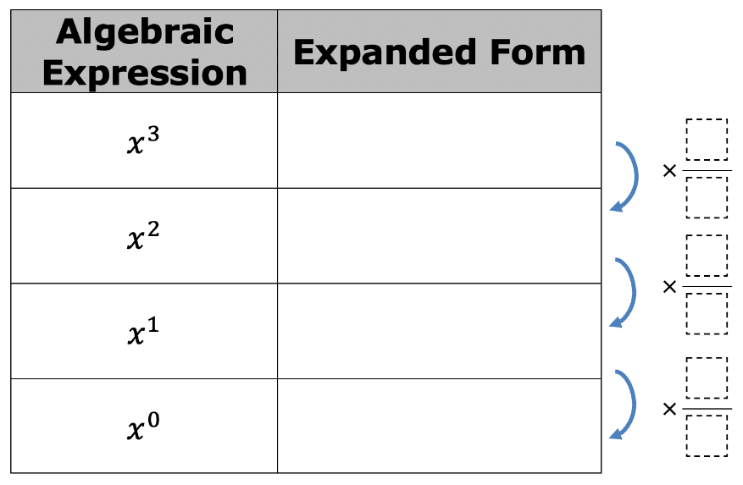
Work with your partner to complete the following to explore negative exponents in algebraic expressions.
Rewrite each expression in expanded form.
Discuss with your partner what factor could be multiplied by each expression to generate the expression in the next row. Then, fill in the blanks to the right of the table.
volume 1, pg. 162

Slide 11
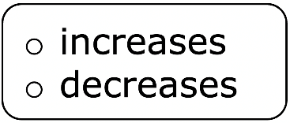
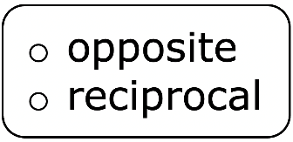
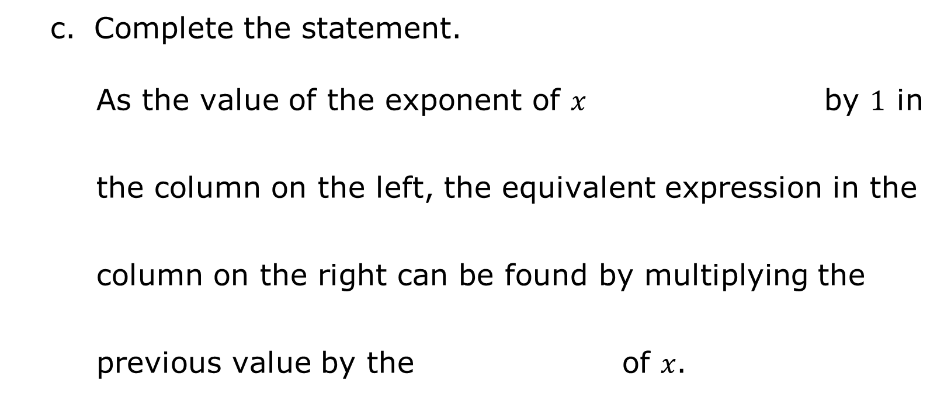
Complete the statement.
As the value of the exponent of 𝑥 by $1$ in the column on the left, the equivalent expression in the column on the right can be found by multiplying the previous value by the of 𝑥.
volume 1, pg. 163

Slide 12
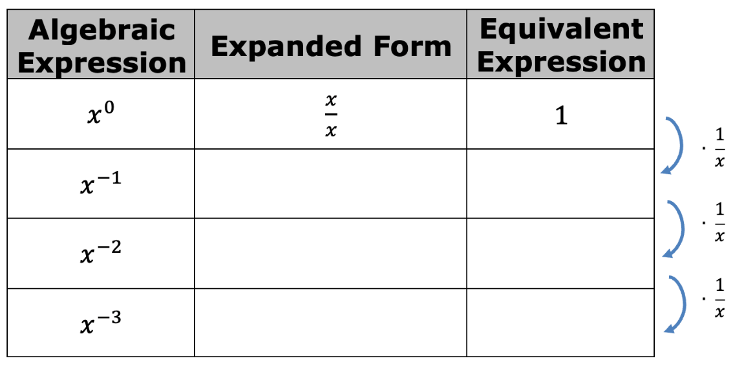
Continue the pattern.
Compare your conjecture in question 2 with the expression you found in Part D.
volume 1, pg. 163

Slide 13
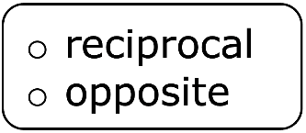
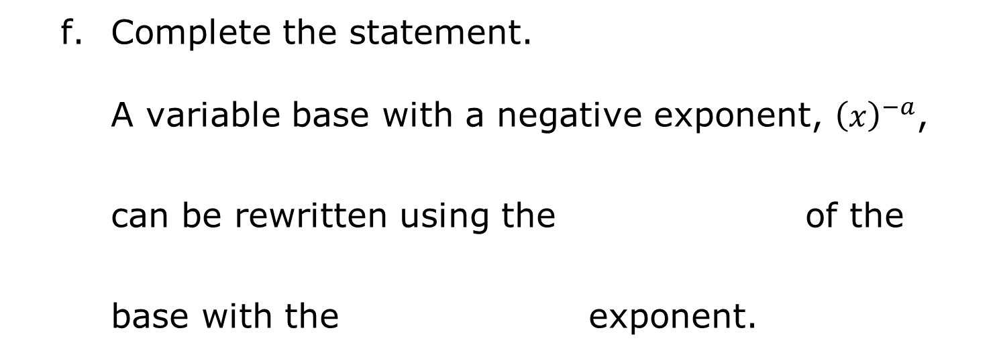
Complete the statement.
A variable base with a negative exponent, ${\left(x\right)}^{−a}$, can be rewritten using the of the base with the exponent.
volume 1, pg. 163

Slide 14

For each expression, write an equivalent expression with positive exponents.
$x^{−4}=______________$
$c^{−9}=______________$
volume 1, pg. 163

Slide 15

${\left(\frac{1}{f}\right)}^{−2}=______________$
${\left(\frac{3}{a}\right)}^{−5}=______________$
volume 1, pg. 163

Slide 16

Activity
volume 1, pg. 164

Slide 17

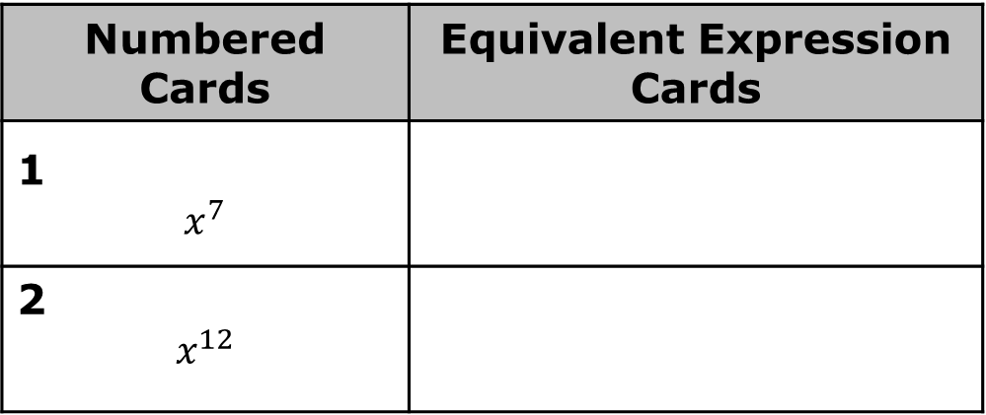
4.9.3 Activity: Equivalent Expressions Card Sort
Work with your partner or group to match the equivalent expressions in the set of cards. Each numbered card in the set shown below has three equivalent matches. Record the letters of the matching cards in the table.
Numbered Cards | Equivalent Expression Cards
1 $$x^{7}$$
2 $$x^{12}$$
volume 1, pg. 164

Slide 18
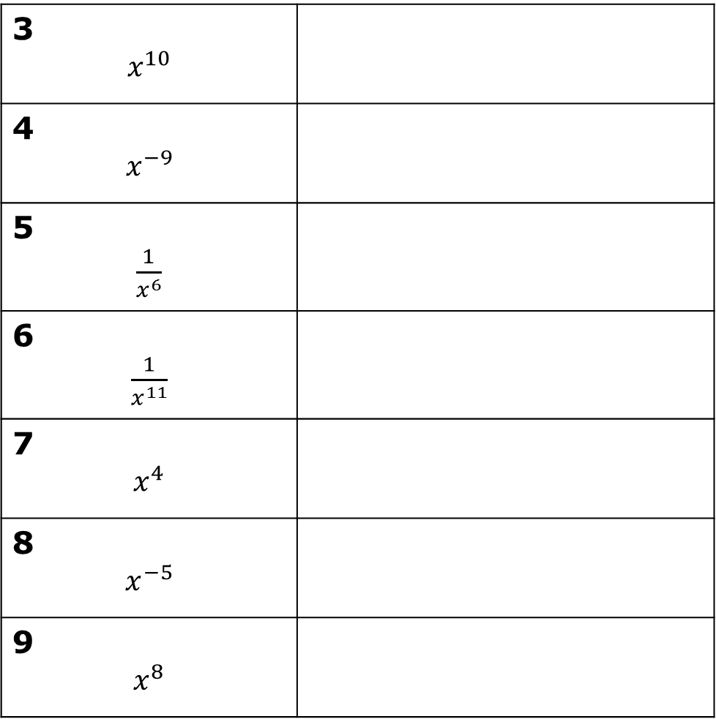
3 $$x^{10}$$
4 $$x^{−9}$$
5 $\frac{1}{x^{6}}$
6 $\frac{1}{x^{11}}$
7 $$x^{4}$$
8 $$x^{−5}$$
9 $$x^{8}$$
volume 1, pg. 164

Slide 19

Your Turn
volume 1, pg. 164

Slide 20
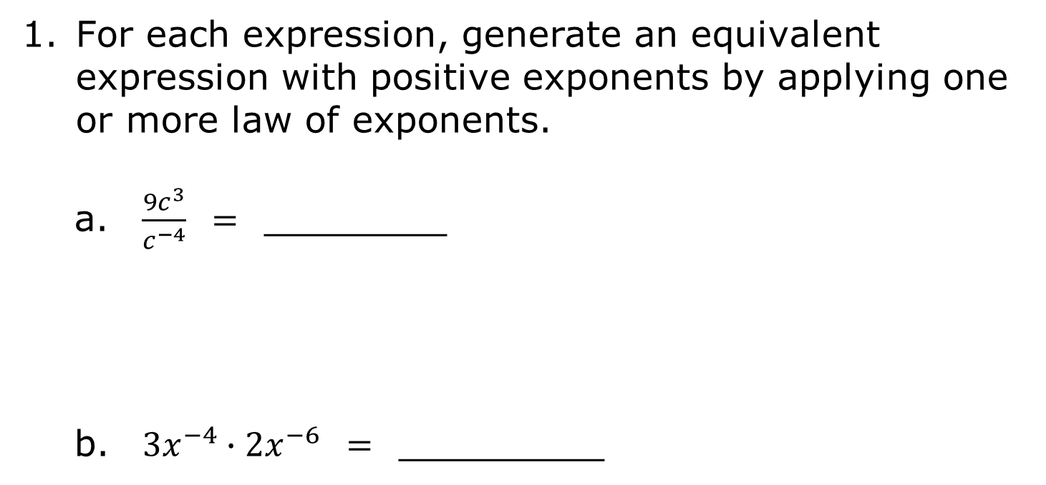
4.9.4 Your Turn!
For each expression, generate an equivalent expression with positive exponents by applying one or more law of exponents.
$\frac{{9c}^{3}}{c^{−4}}$ $=$ ________
${3x}^{−4}∙{2x}^{−6}$ $=$ _________
volume 1, pg. 164

Slide 21
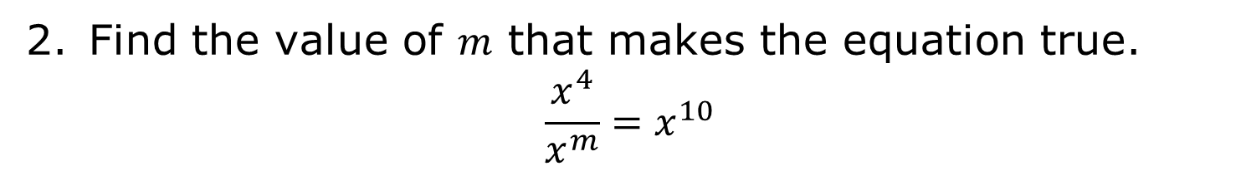
Find the value of $m$ that makes the equation true.
$$\frac{x^{4}}{x^{m}}=x^{10}$$
volume 1, pg. 164

Slide 22

Wrap-Up
volume 1, pg. 165

Slide 23
4.9.5 Wrap-Up: Reflection
Draw an X on the line to indicate how you feel about the learning target.
I can write an equivalent algebraic expression by applying the laws of exponents.
I need help. I can’t get started. | I’m getting there, but I need more practice. | I understand this and I feel confident.
volume 1, pg. 165

